Slide 1





DIGITAL TALENT SCHOLARSHIP
2019
digitalent.kominfo.go.id

Slide 2
Konsep Teknologi Cloud & Virtualisasi
Nama pembicara dengan gelar
2

Slide 3
Konsep Teknologi Cloud Computing
Bagian 1

Slide 4
Komponen Cloud Computing
Komponen dasar
- Clients : LAN, Lapotop , PC, Mobile phone, PDA, dll
• Data Center
- Hardware: Kumpulan server di sebuah gedung
- Software: Virtuallizing server
• Distributed Server
- Server-server yg tersebar di beberapa lokasi

Slide 5
Komponen Cloud Computing
Komponen lain:
• Cloud Application “ Software
• Cloud Services : Produk layanan dan slousi
• Cloud Platform : Hardware & Software
• Cloud Storage
• Cloud Infrastructure

Slide 6
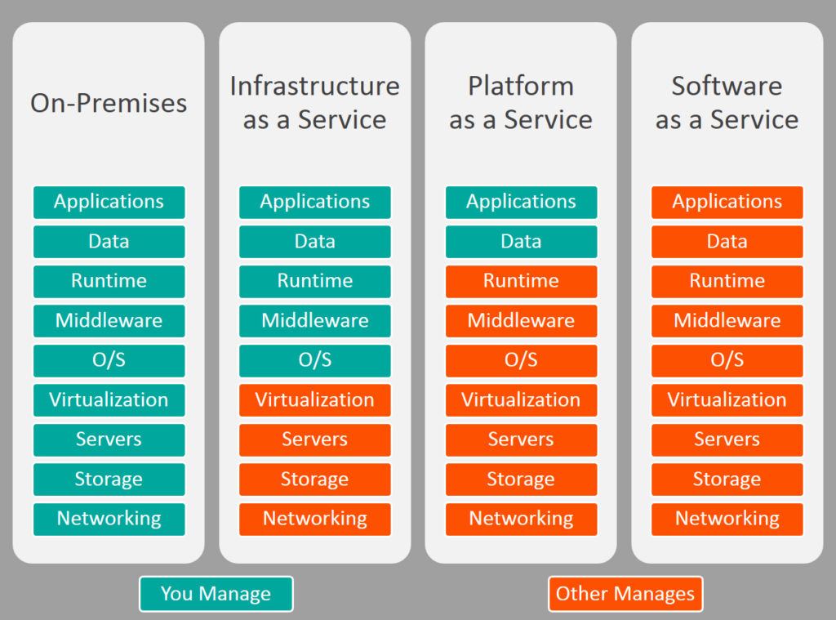
IaaS
PaaS
SaaS

Slide 7
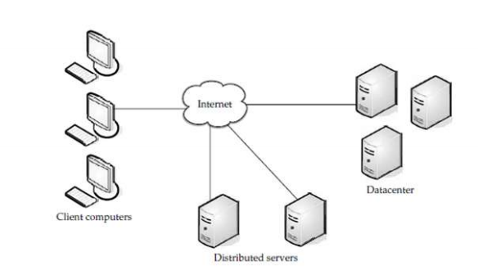
Komponen Cloud Computing

Slide 8
Komponen Cloud Computing
Cloud Client adalah seperangkat komputer ataupun software yang didisain secara khusus untuk penggunaan layanan berbasis cloud computing
- Mobile : Windows mobile, Symbian, dan lain-lain
- Thin Client : Windows terminal service, CherryPal, dll
- Thick Client : Internet explorer, FireFox, dll

Slide 9
Komponen Cloud Computing
Cloud Services adalah produk layanan dan solusi yang dipakai dan disampaikan secara real time melalui media internet. Contoh yang paling populer adalah :
- Identitas : OpenID, Oauth, dan lain-lain
- Integration : Amazon Simple Queue Service, dll
- Payment : Paypal, Google Chekout, dll • Mapping ; Google Maps, Yahoo ! Maps,

Slide 10
Komponen Cloud Computing
Cloud Application : Memanfaatkan cloud computing dalam hal arsitektur software, sehingga user tidak perlu meng-install dan menjalankan aplikasi pada komputer
- Per-to-peer : BitTorent, SETI, dan lain-lain
- Web Application : Facebook
- SaaS : Google Apps, SalesForce.com, dan lain-lain

Slide 11
Komponen Cloud Computing
Cloud Platform merupakan layanan berupa platform komputasi yang berisi software dan hardware infrastruktur, bisanya memiliki aplikasi bisnis tertentu dan menggunakan layanan PaaS sebagai infrastruktur aplikasi bisnisnya, contoh:
- Web Application Framework ; Phyton Django, Rubyan Rails, .Net
- Web Hosting
- Proprietary
- Force.com

Slide 12
Komponen Cloud Computing
• Cloud Storage : Melibatkan proses penyampaian penyimpanan data sebagai sebuah layanan, misalnya
- Database : Google Big Table, Amazon SimpleDB
- Network Attached Storage : Nirvanix CloudNAS, Mobile Me iDisk.

Slide 13
Komponen Cloud Computing
• Cloud Infrastructure : merupakan penyampaian infrastruktur kemampuan sebuah layanan, contohnya :
- Grid Computing : Sun Grid
- Full Virtualization : GoGrid , Skytap
- Compute : Amazon Elastic Compute Cloud

Slide 14
Fitur-fitur Cloud Computing
Self-healing
Multi-tenancy
Virtualized
Linearly Scalable
Resource Monitor and measure
Resource registration and discovery

Slide 15
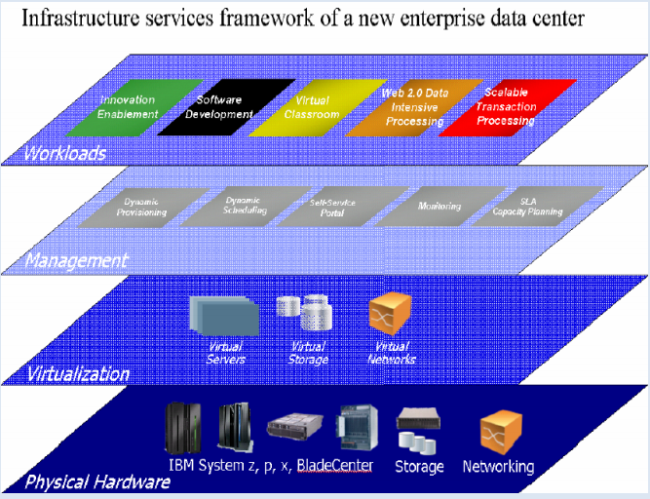
Arsitektur Cloud Computing
Notes:
Layer physical hardware divirtualisasi untuk memberikan platform yang fleksible dan meningkatakn utilisasi resources. Kunci dari new enterprise data center adalah bagaimana mengkombinasikan layer virtualiasi dan layer management agar dapat mengelola data center secara efisien, men-deploy dan meng-configure layanan dengan cepat.

Slide 16
Apa arti Cloud Computing bagi Service Provider ?
Cepat menyediakan layanan
Mengurangi skala server
Meningkatkan tingkat utilisasi resources
Memperbaiki efisiensi pengelolaan
Biaya pemeliharaan lebih rendah
Lokasi infrastruktur di area biaya gedung dan listrik yang rendah

Slide 17
Apa arti Cloud Computing bagi Service Provider ?
Memberikan ‘business continuity service’
Meningkatkan efisiensi manajemen operasional
Meningkatkan ‘service level’
Arsitektur yang kompleks
Mengubah model binis dan tingkat kepercayaan

Slide 18
Apa arti Cloud Computing bagi User ?
Mengurangi beban kerja klien atau beban kerja klien menjadi lebih rendah
• Total Cost Ownership (TCO) lebih rendah
Pemisahan tugas pemeliharaan infrastruktur dari domain-spesifik pengembangan aplikasi
• Pemisahan kode aplikasi dari sumber-daya fisik
Tidak perlu membeli asset untuk ‘pemakaian satu kali’ atau pekerjaan komputing yang tidak sering penggunaanya

Slide 19
Apa arti Cloud Computing bagi User ?
Tidak perlu membeli asset untuk ‘pemakaian satu kali’ atau pekerjaan komputing yang tidak sering penggunaanya
Memperbesar ‘resources on-demand’
Membuat aplikasi memiliki ‘high availability’’
Cepat men-deploy aplikasi
• Membayar apa yang digunakan (Pay per use)

Slide 20
Keuntungan Teknologi Cloud Computing Bagi User
Flexibility:
- User dapat menentekan berapa space storage yang akan digunakan, berapa banyak processing power yang dibutuhkan, dan lain-lain
Scalability:
- User dapat bergerak dari yang kecil ke yang besar dengan cepat

Slide 21
Keuntungan Teknologi Cloud Computing Bagi User
Capital Investment :
- User tidak perlu investasi layanan IT
• Portability :
- User dapat mengakses thin clientnya dari mana saja

Slide 22
Kendala cloud computing
Continuous high availability
Konsistensi (Consistency)
Interoperability dan Standartization
Skalabilitas untuk semua komponen
Data secrecy

Slide 23
Kendala cloud computing
Permasalahan legal dan politik dari penyimpanan data dan translasi menyeberangi region
Issu performansi
Kesulitan kastemisasi
Hambatan organisasi

Slide 24
Kendala Cloud Computing
Service level
Cloud provider mungkin tidak akan konsisten dengan performance dari application atau transaksi.
Mengharuskan anda untuk memahami service level mengenai transaction response time, data protection dan kecepatan data recovery.

Slide 25
Kendala Cloud Computing
Privacy
Karena orang lain / perusahaan lain juga melakukan hosting kemungkinan data anda akan keluar atau di baca oleh pemerintah U.S. dapat terjadi tampa sepengetahuan anda atau approve dari anda.
Compliance
Cloud service provider diharapkan dapat menyamakan level compliance untuk penyimpanan data didalam cloud

Slide 26
Kendala Cloud Computing
Data ownership
Apakah data anda masih menjadi milik anda begitu data tersebut tersimpan didalam cloud?
Mungkin pertanyaan ini sedikit aneh, namun anda perlu mengetahui seperti hal nya yang terjadi pada Facebook yang mencoba untuk merubah terms of use aggrement nya yang mempertanyakan hal ini.

Slide 27
Kendala Cloud Computing
Data Mobility
Apakah anda dapat melakukan share data diantara cloud service?
Jika anda terminate cloud relationship bagaimana anda mendapatkan data anda kembali?
Format apa yang akan digunakan?
Dapatkah anda memastikan kopi dari datanya telah terhapus?

Slide 28
Issu-issu Pada cloud computing
Privileged user access.
Regulatory compliance.
Data location.
Data segregation.
Recovery.
Investigative support.
Long-term viability.

Slide 29
Pengguna dan Penyelenggara Layanan Cloud Computing
Contoh 10 Perusahaan pengguna Cloud
Contoh Penjyedia Layanan SaaS
Contoh Penjyedia Layanan PaaS
Contoh Penjyedia Layanan IaaS

Slide 30
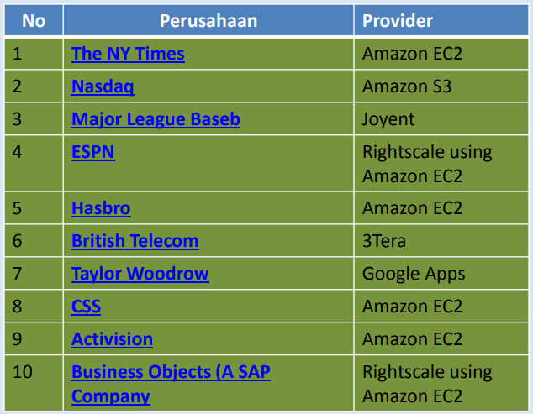
10 Contoh Perusahaan Pengguna Layanan clouds

Slide 31
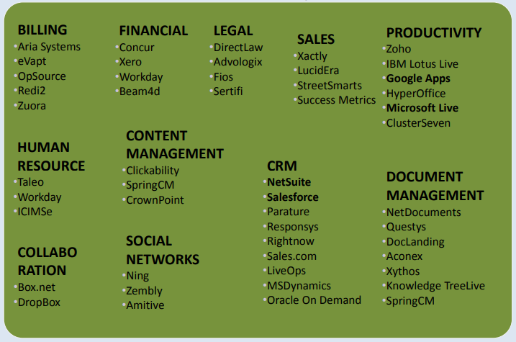
Contoh Penyedia Layanan SAAS (Software as a Service)

Slide 32
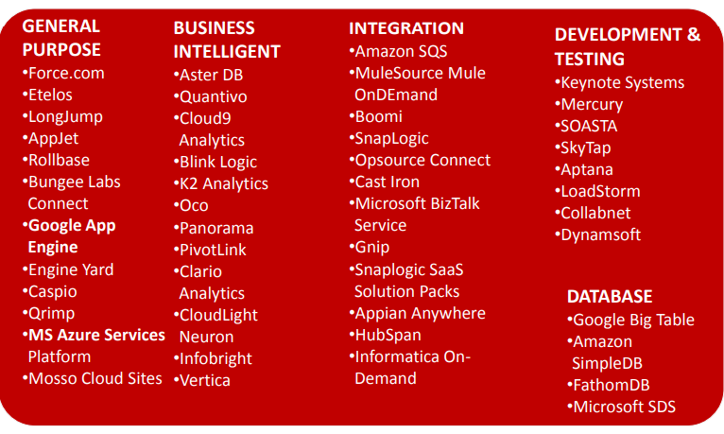
Contoh Penyedia Layanan PAAS (Platform as a Service)

Slide 33
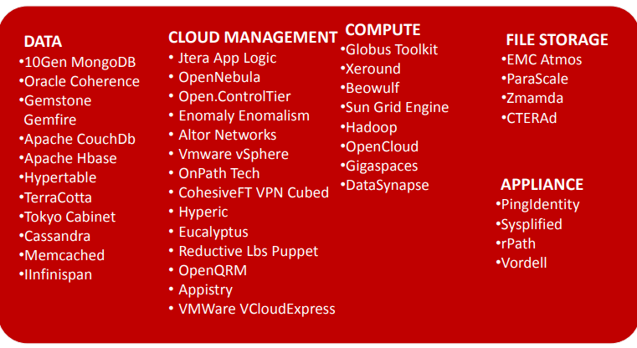
Contoh Penyedia Layanan PAAS (Platform as a Service) - lanjutan

Slide 34
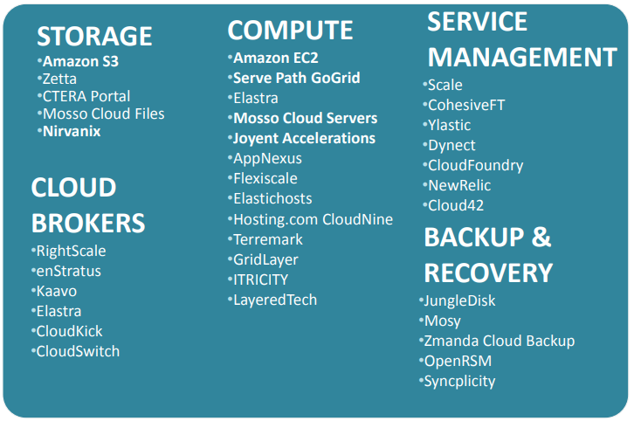
Contoh Penyedia Layanan IAAS (Infrastructure as a Service)

Slide 35
Virtualization
Bagian 2

Slide 36
Virtualisasi
Virtualisasi adalah istilah luas pemisahan sumber daya komputer (jaringan, storage dan server)
Virtualisasi menyembunyikan karakteristik fisik sumber daya komputasi ke pengguna (aplikasi atau end-user)

Slide 37
Virtualisasi
Sebuh physical resources (sebuah server/aplikasi /storage) dapat terlihat seperti beberapa resources virtual dan sebaliknya.
Teknologi virtual : Virtualisasi storage, virtualisasi komputasi dan virtualisasi network

Slide 38
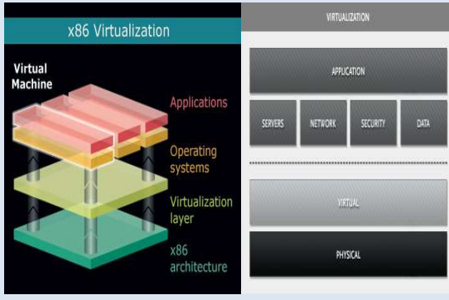
Virtualisasi

Slide 39
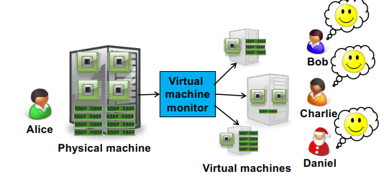
Virtualization is key enabler
Notes:
Alice can sell each customer a virtual machine (VM) with the requested resources – From each customer’s perspective, it appears as if they had a physical machine all by themselves (isolation)

Slide 40
The idea of Virtualization: from 1960’s
IBM VM/370 – A VMM for IBM mainframe - Multiple OS environments on expensive hardware - Desirable when few machine around
Popular research idea in 1960s and 1970s - Entire conferences on virtual machine monitors - Hardware/VMM/OS designed together - Allowed multiple users to share a batch oriented system

Slide 41
The idea of Virtualization: from 1960’s
Interest died out in the 1980s and 1990s
Hardware got more cheaper
Operating systems got more powerful (e.g. multi-user)

Slide 42
A Return to Virtual Machines
Disco: Stanford research project (SOSP ’97) - Run commodity OSes on scalable multiprocessors - Focus on high-end: NUMA, MIPS, IRIX
Commercial virtual machines for x86 architecture - VMware Workstation (now EMC) (1999-) - Connectix VirtualPC (now Microsoft)

Slide 43
A Return to Virtual Machines
Research virtual machines for x86 architecture
Xen (SOSP ’03)
Plex86
OS-level virtualization - FreeBSD Jails, User-mode-linux, UMLinux

Slide 44
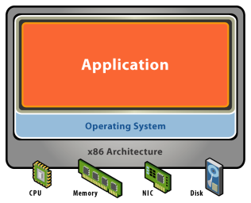
Starting Point: A Physical Machine
Physical Hardware
Processors, memory, chipset, I/O devices, etc.
Resources often grossly underutilized
Software
Tightly coupled to physical hardware
Single active OS instance
OS controls hardware

Slide 45
What is a Virtual Machine?
Software Abstraction
Behaves like hardware (cek hardware atau software?)
Encapsulates all OS and application state
Virtualization Layer
Extra level of indirection
Decouples hardware, OS
Enforces isolation
Multiplexes physical
hardware across VMs

Slide 46
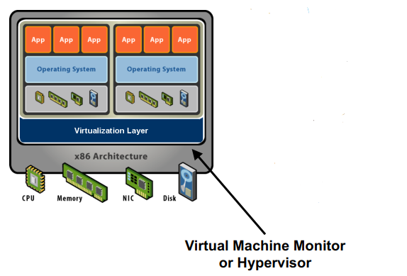
What is a Virtual Machine?

Slide 47
Virtualization Properties, Features
Isolation
Fault isolation
Performance isolation (+ software isolation, …)
Encapsulation
Cleanly capture all VM state
Enables VM snapshots, clones

Slide 48
Virtualization Properties, Features
Portability
Independent of physical hardware
Enables migration of live, running VMs (freeze, suspend,…)
Interposition
Transformations on instructions, memory, I/O
Enables transparent resource overcommitment, encryption, compression, replication …

Slide 49
Types of Virtualization
Hardware
emulation – VM emulates/simulates complete hardware
QEMU
paravirtualization - software interface to virtual machines
Xen
full virtualization - complete simulation of the underlying hardware
VMWare, Parallels

Slide 50
Types of Virtualization
Memory virtualization
decouples volatile random access memory (RAM) resources from individual systems
aggregates these resources into a virtualized memory pool available to any computer in the cluster
Storage virtualization
abstracting logical storage from physical storage
NAS - network attached storage

Slide 51
Types of Virtualization
Data virtualization
data as an abstract layer, independent of underlying database systems, structures and storage
Network virtualization
virtualized network addressing space within or across network subnets
VPNs

Slide 52
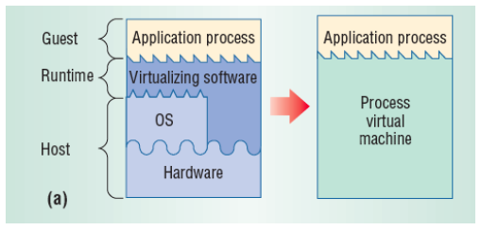
Types of Virtualization
Process Virtualization - Language-level Java, .NET, Smalltalk - OS-level processes, Solaris Zones, BSD Jails, Docker Containers - Cross-ISA emulation Apple 68K-PPC-x86

Slide 53
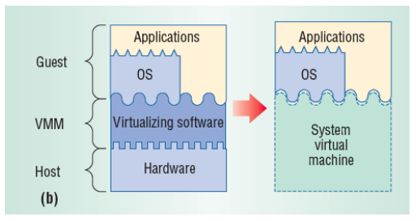
Types of Virtualization
System Virtualization - VMware Workstation, Microsoft VPC, Parallels - VMware ESX, Xen, Microsoft Hyper-V

Slide 54
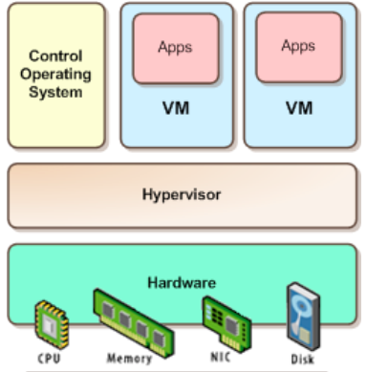
Types of System Virtualization
Native/Bare metal (Type 1) - Higher performance - ESX, Xen, HyperV

Slide 55
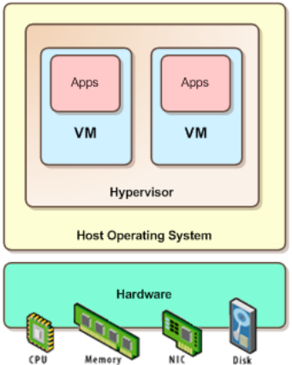
Types of System Virtualization
Hosted (Type 2) - Easier to install - Leverage host’s device drivers - VMware Workstation, Parallels

Slide 56
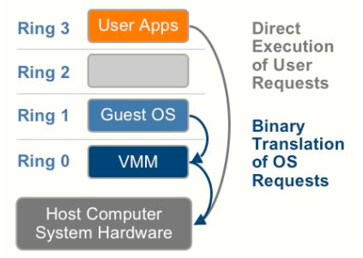
Types of Virtualization
Full virtualization (e.g.VMWare ESX) - Unmodified OS,virtualization is transparent to OS - VM looks exactly like aphysical machine

Slide 57
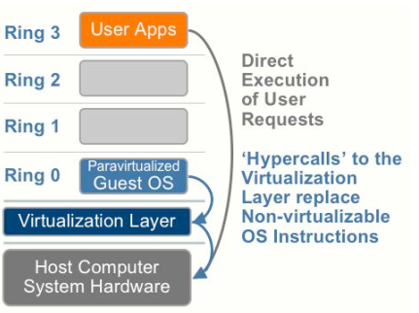
Types of Virtualization
Para virtualization (e.g. XEN) - OS modified to be virtualized, - Better performance at cost of transparency

Slide 58
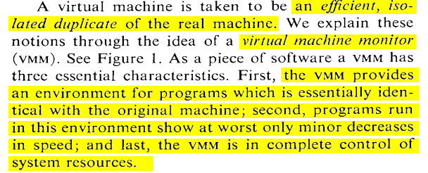
What is a Virtual Machine Monitor?
Classic Definition (Popek and Goldberg ’74)

Slide 59
What is a Virtual Machine Monitor?
VMM Properties - Equivalent execution - Performance - Safety and isolation
Notes:
– Equivalent execution: Programs running in the virtualized environment run identically to running natively – Performance: A statistically dominant subset of the instructions must be executed directly on the CPU – Safety and isolation: A VMM most completely control access to system resources

Slide 60
VMM Implementation Goals
• Should efficiently virtualize the hardware - Provide illusion of multiple machines - Retain control of the physical machine
• Which subsystems should be virtualized? - Processor => Processor Virtualization - Memory => Memory Virtualization - I/O Devices => I/O virtualization

Slide 61
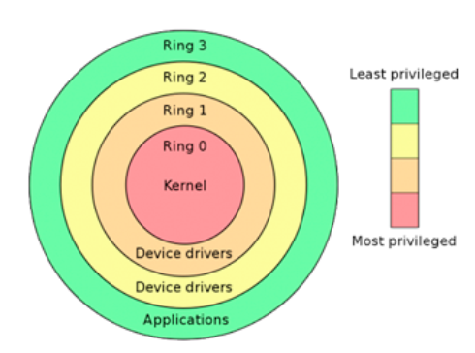
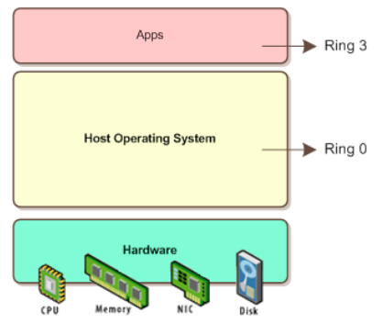
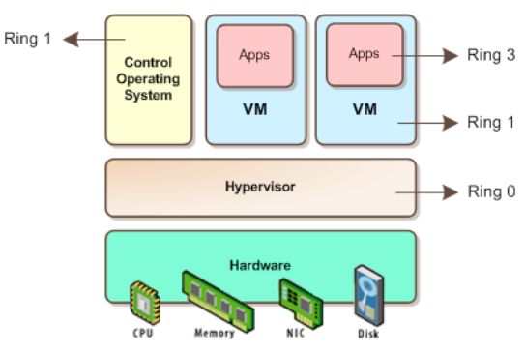
Processor Virtualization
An architecture is classically/strictly virtualizable if all its sensitive instructions (those that violate safety and encapsulation).
Notes:
all instructions either trap or execute identically • instructions that access privileged state trap

Slide 62
Shadow Page Tables
Three abstractions of memory
Machine
Physical
Virtual
In each VM, OS creates and manages page tables for its virtual address spaces without modification - But these page tables are not used by the MMU
Notes:
• Machine: actual hardware memory (e.g. 2GB of DRAM) • Physical: abstraction of hardware memory, OS managed – E.g. VMM allocates 512 MB to a VM, the OS thinks the computer has 512 MB of contiguous physical memory – (Underlying machine memory may be discontiguous) • Virtual: virtual address space – Standard 232 address space

Slide 63
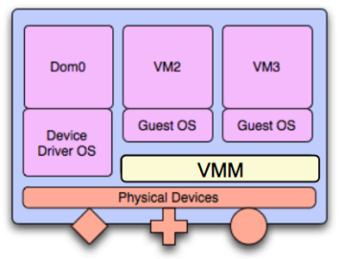
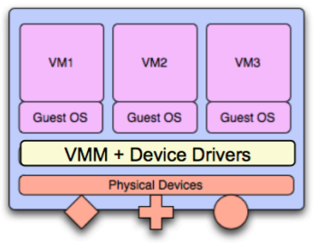
I/O Virtualization
Challenge
Insight
Solution
Notes:
Challenge: Lots of I/O devices – Problem: Writing device drivers for all I/O devices in the VMM layer is not a feasible option • Insight: Device driver already written for popular OSes • Solution: Present virtual I/O devices to guest VMs and channel I/O requests to a trusted host VM (popular OS)

Slide 64
Virtualizing I/O Devices
However, overall I/O is complicated for VMMs – Many short paths for I/O in OSes for performance – Better if hypervisor needs to do less for I/O for guests, – Possibilities include direct device access, DMA passthrough, direct interrupt delivery (need H/W support!)

Slide 65
Virtualizing I/O Devices
Networking also complex as VMM and guests all need network access - VMM can bridge guest to network (direct access) - VMM can provide network address translation (NAT)
NAT address local to machine on which guest is running
VMM provides address translation to guest to hide its address

Slide 66
Karakteristik Cloud Computing
Bagian 3

Slide 67
NIST Essential Characteristics
On-demand self-service
a consumer can unilaterally provision computing capabilities without human interaction with the service provider computing capabilities server time, network storage, number of servers etc.

Slide 68
NIST Essential Characteristics
Broad network access
capabilities are : - available over the network - accessed through standard mechanisms
promote use by : - heterogeneous thin or thick client platforms

Slide 69
NIST Essential Characteristics
Multi-tenancy / Resource pooling
provider’s computing resources are pooled to serve multiple consumers
computing resources
storage, processing, memory, network bandwidth and virtual machines

Slide 70
NIST Essential Characteristics
Location independence - no control over the exact location of the resources
Has major implications - performance, scalability, security

Slide 71
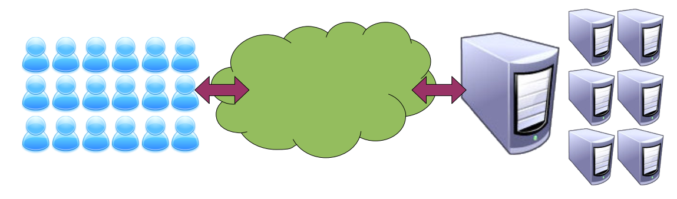
NIST Essential Characteristics
Rapid elasticity - capabilities can be rapidly and elastically provisioned - unlimited virtual resources
Rapid elasticity - capabilities can be rapidly and elastically provisioned - unlimited virtual resources - predicting a ceiling is difficult

Slide 72
NIST Essential Characteristics
Measured service - metering capability of service/resource abstractions - storage - processing - bandwidth - active user accounts
OK so what happened to utility computing – pay as you go model?? - more on this later when we discuss deployment models

Slide 73
Basic Cloud Characteristics
The “no-need-to-know” in terms of the underlying details of infrastructure, applications interface with the infrastructure via the APIs.
The “flexibility and elasticity” allows these systems to scale up and down at will
utilising the resources of all kinds
CPU, storage, server capacity, load balancing, and databases

Slide 74
Basic Cloud Characteristics
The “pay as much as used and needed” type of utility computing and the “always on, anywhere and any place” type of network-based computing.
Cloud are transparent to users and applications, they can be built in multiple ways
branded products, proprietary open source, hardware or software, or just off-the-shelf PCs.

Slide 75
Basic Cloud Characteristics
In general, they are built on clusters of PC servers and off-the-shelf components plus Open Source software combined with in-house applications and/or system software.

Slide 76
Cloud computing takes virtualization to the next step
You don’t have to own the hardware
You “rent” it as needed from a cloud
There are public clouds
e.g. Amazon EC2, and now many others (Microsoft, IBM, Sun, and others ...)
A company can create a private one
With more control over security, etc.

Slide 77
Goal 1 – Cost Control
Cost
Many systems have variable demands
Batch processing (e.g. New York Times)
Web sites with peaks (e.g. Forbes)
Startups with unknown demand (e.g. the Cash for Clunkers program)
Reduce risk
Don't need to buy hardware until you need it

Slide 78
Goal 2 - Business Agility
More than scalability - elasticity
Ely Lilly in rapidly changing health care business
Used to take 3 - 4 months to give a department a server cluster, then they would hoard it
Using EC2, about 5 minutes
And they give it back when they are done
Scaling back is as important as scaling up

Slide 79
Goal 3 - Stick to Our Business
Most companies don't WANT to do system administration
Forbes says:
We are is a publishing company, not a software company
But beware:
Do you really save much on sys admin?
You don't have the hardware, but you still need to manage the OS!

Slide 80
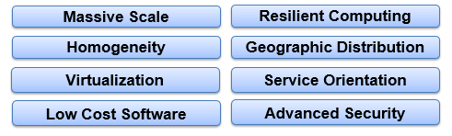
Cloud Computing Characteristics
Common Characteristics:

Slide 81
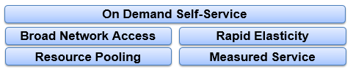
Cloud Computing Characteristics
Essential Characteristics:

Slide 82
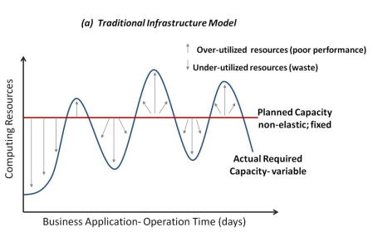
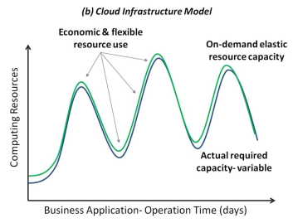
Elasticity – Cloud Computing
Elasticity - Hosting Vs. IaaS Cloud
• On-demand computing resources – e.g., servers, storage • Efficient use of resources – pay per usage time (pay-as-you-go)

Slide 83
What is Elasticity (Auto-Scaling)?
The ability of a system to dynamically adapt its underlying computing infrastructure resources in response to variable workload changes over time
Can be at SaaS, PaaS, IaaS
IaaS Elasticity - Adding/removing virtual or physical servers - Increasing/decreasing CPU, memory and storage capacity by adding/removing additional hardware components to existing machines

Slide 84
What is Elasticity (Auto-Scaling)?
Increasing/decreasing network speed and number of IP addresses
Increasing/decreasing amount of data transfer and number of data operations/requests of cloud resources
• Manual (user interface) vs. automated means (APIs)
- Auto-scaling

Slide 85
IaaS Elasticity and Web Applications
Key characteristics of Web applications
Highly transactional - business value
Commodity - Variable workload patterns
IaaS cloud
On-demand computing resources/services – pay-as-you-go

Slide 86
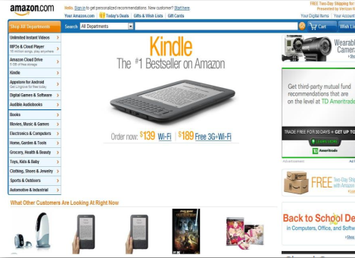
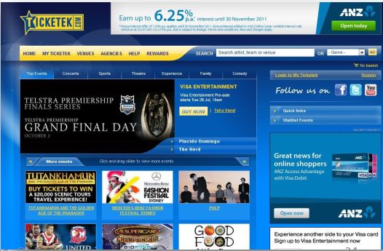
IaaS Elasticity and Web Applications

Slide 87
Case Study – Animoto AWS Elasticity
Animoto an online video service, makes it easy to make and share videos in just a few minutes
The company launched in 2007 using its own servers, but moved to AWS for additional capacity
When Animoto integrated with Facebook in 2008, attracting 750,000 new users in 3 days, it used AWS to handle the load.

Slide 88
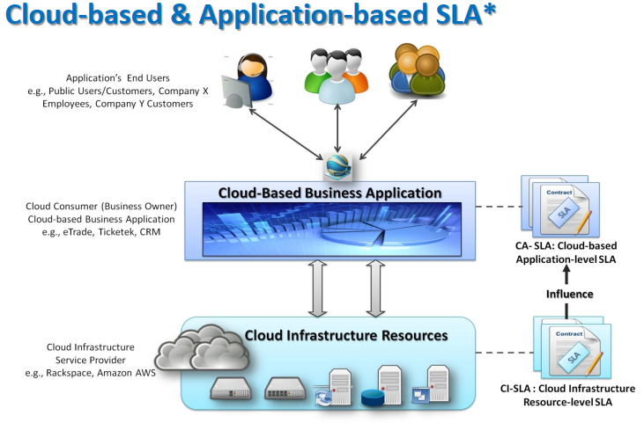
Case Study – Animoto AWS Elasticity

Slide 89
Characteristics of Multi-Tenancy
Isolation
Scaling conveniently with the number and size of tenants
Meet SLAs for each tenant
Support for per-tenant service customization
Support for value-adding ops, e.g., backup, upgrade
Secure data processing and storage
Support for regulatory law (per legislator, per tenant)
Notes:
1. Isolation = separation of services provided to each tenant (the noisy neighbor) 2. Scaling conveniently with the number and size of tenants (max weight in the elevator) 3. Meet SLAs for each tenant 4. Support for per-tenant service customization 5. Support for value-adding ops, e.g., backup, upgrade 6. Secure data processing and storage (the snoopy neighbor) 7. Support for regulatory law (per legislator, per tenant)

Slide 90
Benefits of Multi-Tenancy (the Promise)
Cloud operator
Economy of scale
Market-share and branding (for the moment)
Users
Flexibility
Focus on core expertise
Reduced cost
Reduced time-to-market
Overall
Reduced cost of IT deployment and operation

Slide 91
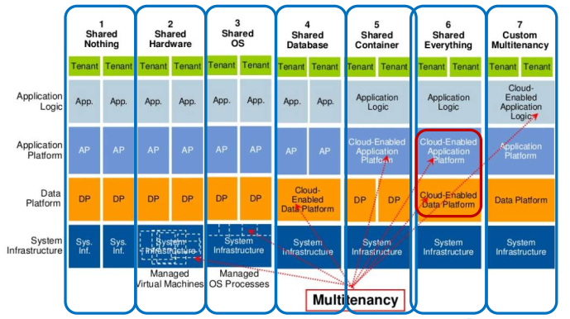
Architecture For Multitenancy

Slide 92
Cloud Concepts Overview
Bagian 4

Slide 93
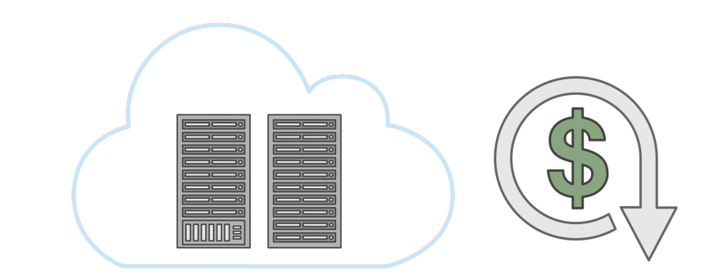
Introduction to the AWS Cloud
Cloud Computing (Komputasi Cloud)
On-demand delivery of IT resources and applications via the internet with pay-as-you-go pricing
Notes:
Komputasi cloud adalah pengiriman berdasarkan permintaan untuk daya komputasi, database, penyimpanan, aplikasi, dan sumber daya IT lain melalui platform layanan cloud via internet dengan harga sesuai penggunaan.
Contohnya jika kita menjalankan linux virtual mesin selama 5 jam, biaya yang dibayarkan hanya 5 jam saja.

Slide 94
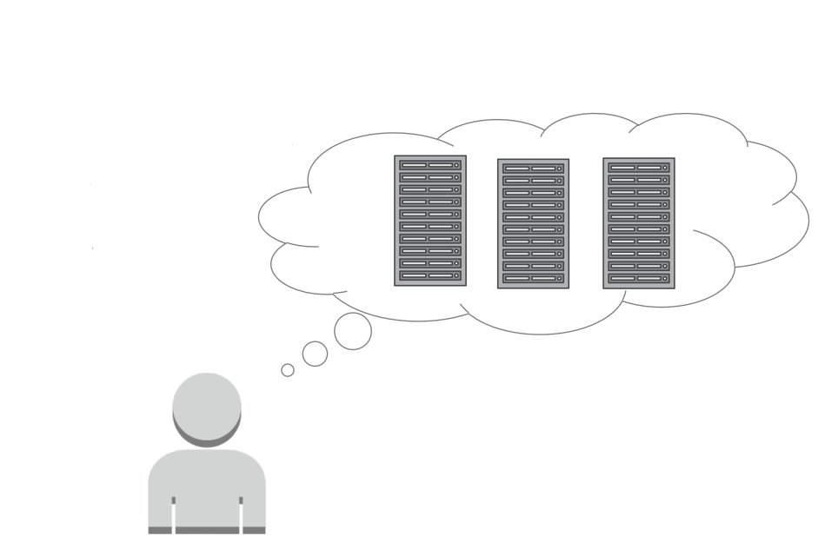
Before AWS
AWS Architecting
Guessing theoretical maximum peaks?
Is there enough resource capacity?
Is this sufficient storage?
Notes:
Sebelum adanya AWS, kita harus menentukan kapasitas sumber daya yang dibutuhkan. Karena jika tidak menentukan hal tersebut akan mengakibatkan kita harus membayar mahal untuk sumber daya baik ketika sumber daya tersebut dipakai ataupun tidak

Slide 95
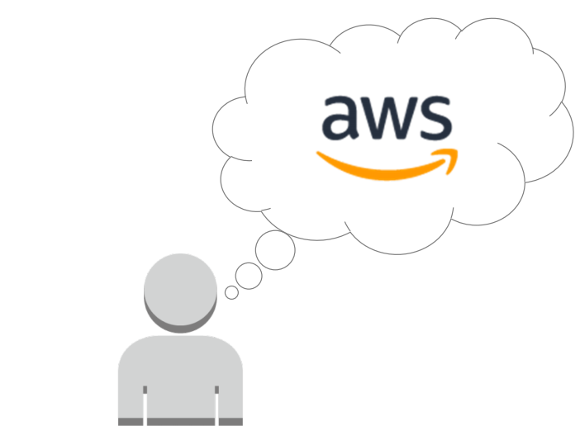
With AWS
With AWS:
Servers
Databases
Storage
Higher-level applications
Notes:
Dengan menggunakan AWS, memudahkan kita untuk mengakses server, database, storage dan komponen aplikasi tingkat tinggi melalui internet. Bahkan layanan AWS ini dapat dimulai dalam hitungan detik tanpa harus memiliki banyak rak secara fisik dan bertumpuk, hanya dengan memanggil API

Slide 96
With AWS
Resouces can be:
Initiated within second
Treated as “temporary and disposable”
Free from the inflexibility and constraints
Notes:
Dengan AWS, kita tidak hanya bisa menginisiasi sumber daya TI dalam hitungan detik, tapi juga bisa menggunakannya untuk sumber daya yang bersifat sementara dan sekali pakai.
Dan dengan AWS kita dapat melakukan pendekatan untuk mengubah pengujian manajemen, realibilitas dan perencanaan kapasitas yang dibutuhkan dengan lebih gesit dan efisien

Slide 97
AGILITY
3 Factors :
Speed
Experimentation
Cultur of innovation
Notes:
Salah satu alasan untuk berpindah mengunakan cloud adalah meningkatnya ketangkasan dalam pengolahan sumber daya.
Terdapat tiga faktor yang mempengaruhi ketangkasan cloud computing, yaitu :
Kecepatan, bereksperimen atau mencoba hal baru dan berinovasi

Slide 98

Agility: Increase Speed and Global Reach
Instant global reach
Rapid availability of new resources
Notes:
AWS menawarkan jangkauan secara global dan kita bisa mendapatkan manfaat yang banyak tanpa harus melakukan investasi awal yang besar.
dengan cloud computing, kita dapat mengurangi waktu yang lama menjadi lebih cepat untuk membuat suatu sumber daya. Terutama bagi pengembang yang awalnya membutuhkan waktu beberapa minggu menjadi hanya beberapa menit saja yang menghasilkan peningkatan kinerja untuk suatu organisasi.

Slide 99

Agility: Increase Experimentation
AWS enables
Operations as code
Safe Experimentation
Comparative testing
Notes:
Keuntungan dari ketangkasan suatu cloud computing adalah dapat melakukan berbagai eksperimen lebih sering.
AWS memungkinkan berbagai operasi sebagai suatu kode dalam cloud dan memiliki kesempatan untuk mengembangkan berbagai eksperimen dengan aman, baik untuk mengembangkan suatu prosedur operasional ataupun mempraktekan suatu kegagalan.
Misal, dengan AWS kita dapat spin-up server dalam hitungan menit kemudian mengembalikannya kedalam keadaan semula atau menggunakannya kembali untuk percobaan yang lain. Dengan virtual resource dan automatable kita dapat dengan cepat melakukan perbandingan pengujian komparatif menggunakan berbagai jenis contoh penyimpanan atau konfigurasi.
menggunakan layanan seperti AWS cloud memungkinkan kita untuk konsisten dalam uji dan produksi template dan kebutuhan produksi dengan peningkatan level dari operational control

Slide 100
Agility: Increase Innovation
Quick experimentation with low cost/risk
More experimentation and more often
Notes:
Dengan mempergunakan cloud, akses ke suatu sumber daya dengan biaya yang rendah, kemudian berkurangnya juga suatu risiko dan dorongan yang lebih sering untuk melakukan percobaan ataupun mengembangkan suatu inovasi.
Hal ini sangat bagus dalam bidang IT karena mengarah pada suatu penemuan baru, konfigurasi dan inovasi secara berurutan

Slide 101

Agility: The AWS Infrastructure
Instant elasticity
Scalability
Flexible
Reliability
Secure
Notes:
Skalabilitas
Infrastuktur Global AWS memungkinkan perusahaan menjadi teramat fleksibel dan menerima manfaat skalabilitas cloud yang tak terbatas secara konseptual. Kapasitas komputasi AWS naik pada tingkat yang tak tertandingi, menambah kapasitas komputasi pada perusahaan Fortune 500 setiap harinya. Kenaikan konstan dalam kapasitas ini mendorong automasi peningkatan pada proses dan praktik operasional AWS, yang membantu memastikan perusahaan yang bergantung pada AWS untuk selalu terbarukan. Perusahaan dapat menyediakan sumber daya yang dibutuhkan dengan cepat, yang menerapkan ratusan bahkan ribuan server dalam beberapa menit.
Keamanan
Keamanan di AWS dimulai dengan infrastruktur inti. Dibuat khusus untuk cloud dan dirancang untuk memenuhi persyaratan keamanan yang lebih ketat di dunia, infrastruktur AWS dipantau 24/7 untuk membantu memastikan kerahasiaan, integritas, dan ketersediaan data pelanggan. Pelanggan dapat membuat infrastruktur global paling aman sehingga yakin bahwa mereka selalu memiliki datanya, termasuk kemampuan mengenkripsi, memindahkan, dan mengelola penyimpanannya.
Elastisitas
Sebelum komputasi cloud, kita harus banyak menyediakan infrastruktur untuk memastikan bahwa kita memiliki kapasitas cukup untuk menangani bisnis operasi di tingkat puncak aktivitas. Sekarang, kita dapat menyediakan jumlah sumber daya yang benar-benar dibutuhkan, mengetahui bahwa kita juga dapat secara instan menaikkan atau menurunkan skala dengan kebutuhan bisnis. Ini mengurangi biaya dan meningkatkan kemampuan kita untuk memenuhi permintaan pengguna.
Reliability
Memulihkan failure
Sumber daya sesuai permintaan
Mengurangi gangguan

Slide 102
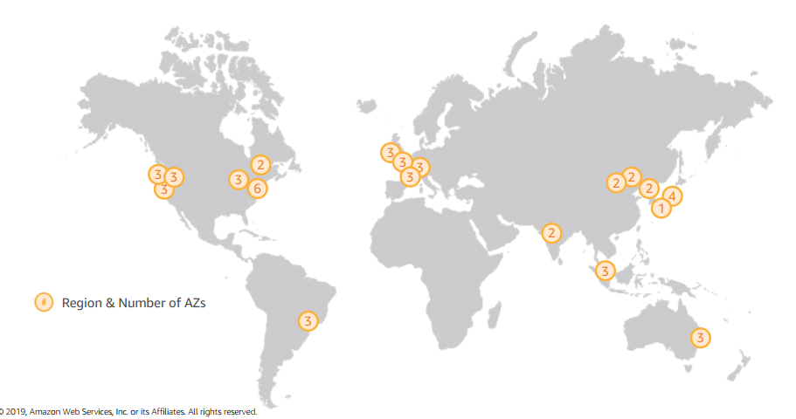
Regions and Availability Zones
Notes:
Pada gambar, bagian yang dilingkari dengan warna oranye adalah angka-angka yang terdapat pada lingkaran tersebut adalah jumlah dari Availiability Zone (AZ) yang masuk pada wilayah tersebut dengan area geografis yang berisi dua atau lebih banyak dari AZ. Atau wilayah AZ adalah entitas yang terpisah satu sama lain dan sumber daya dalam satu wilayah tidak secara otomatis di replikasi ke wilayah lain.
Penting untuk mempertimbangkan wilayah mana yang akan membantu kita untuk mengoptimalkan latensi, meminimalkan biaya dan mematuhi peraturan apapun yang ada.
Jika kita memanfaatkan layanan cloud computing, kita dapat menggunakan aplikasi yang ada di beberapa wilayah dengan mudah.
Contoh :
Kita memiliki aplikasi di wilayah terdekat dengan kantor pusat terbesar di Singapura. Kemudian kita memiliki basis pelanggan yang terletak di Melbourne, Australia. Hanya dengan beberapa klik saja kita dapat menyebarkan informasi di dua wilayah tersebut bahkan hingga ke wilayah sydney, sambil meminimalkan latensi dan meningkatkan semua ketangkasan untuk organisasi kita. Dan semuanya dilakukan hanya dalam beberapa menit saja dan dengan biaya yang minimal.
Di wilayah arab memiliki lebih dari 105 layanan pada Agustus 2018 mulai dari penyimpanan komputasi, keamanan hingga Internet of Things (IOT), kecerdesan buatan, hingga AI.

Slide 103
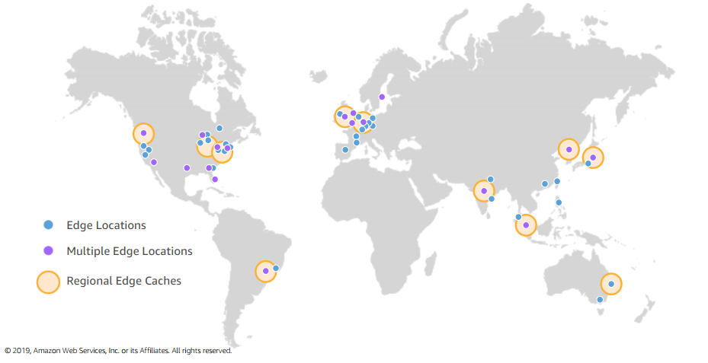
Edge Locations
Notes:
Untuk mengirimkan konten kepada end-user dengan latensi lebih rendah pada Agustus 2018, AWS menggunakan jaringan global di 114 titik kehadiran (103 edge location dan 11 Cache Edge Regional) di 56 kota di 24 negara.
Terakhir pada 2019 ini, AWS menggunakan jaringan global di 180 Titik Kehadiran (169 Lokasi Edge dan 11 Cache Edge Regional) di 69 kota di 30 negara.
Regional edge caches digunakan untuk mengoptimalkan cache di edge location sehingga pengguna memiliki kemungkinan lebih tinggi untuk mengakses informasi di sana daripada meminta pada server asli yang mengakibatkan latensi tinggi.
Edge location :
Amazon CloudFront
AWS Shield
AWS Web Application Firewall (WAF)
Amazon Route 53

Slide 104
High Availability
High availability
Functional and accessible system
Minimized downtime
No human intervention
Notes:
Pelanggan AWS yang berfokus pada ketersediaan tinggi (High Availability) dapat merancang aplikasi mereka untuk berjalan di beberapa Zona Ketersediaan (Availability Zone) untuk mencapai toleransi kesalahan yang lebih besar.

Slide 105
Fault Tolerance
Fault Tolerance:
Operational applications during
component failure
Built-in redundancy of components

Slide 106
Elasticity, Scalability, and High Performance
AWS
Elastic infrastructure
Innovative new services/products
Deployment in multiple regions
Lower latency
Better customer experience
Notes:
AWS menggunakan teknologi jaringan ethernet yang canggih. Jaringan ini terus mendapatkan keuntungan dari perkembangan pesat Amazon sehingga pelanggan menemukan bahwa aplikasi yang besar pun berjalan dengan sangat baik pada AWS.
Elastic infrastruktur : elastisitas memungkinkan kita untuk menyesuaikan/mencocokan pasokan sumber daya dengan permintaan terutama sumber daya yang membutuhkan biaya. Karena sumber daya cloud dibayar berdasarkan penggunaannya saja, sehingga elastisitas ini sangat bermanfaat untuk optimasi biaya.
Elastistas terdiri dari 2 jenis, yaitu elastisitas berbasis waktu dan volume. Elastisitas berbasis waktu berarti mematikan sumber daya yang tidak digunakan, sedangkan elastisitas berbasis volume berarti mencocokan dengan intensitas permintaan, misal untuk mengukur ukuran penyimpanan yang diperlukan.
Dengan menggunakan AWS kita dapat menikmati secara konsisten menggunakan layanan yang inovatif dan teknologi mutakhir tanpa harus melalui beberapa siklus pengadaan dan evaluasi yang mahal. Selain itu kita juga dapat dengan mudah menyebarkan sistem diberbagai wilayah di dunia untuk memberikan latensi yang lebih rendah dan pengalaman yang lebih baik untuk pelanggan

Slide 107
Elasticity, Scalability, and High Performance
Customer
Use services at your own pace
Use tools to meet your needs
Adapt your consumption
Scale up as workload grows
Shutdown unneeded resources
Use Auto Scaling
Notes:
Salah satu manfaat untuk pelanggan AWS adalah mendapatkan layanan dengan kecepatan yang diinginkan.
AWS juga menghadirkan skalabilitas cloud computing yang dirancang untuk high avaliability dan depandility sehingga memungkinkan untuk kita menjalankan berbagai aplikasi.

Slide 108

Security and Compliance
You retain control over region where data is located
Security auditing
Periodic and manual
AWS cloud offer capabilities
For governance
To meet the strictest security requirements
Notes:
Security Keamanan cloud di AWS adalah prioritas tertinggi. Sebagai pelanggan AWS, kita akan mendapat manfaat dari pusat data dan arsitektur jaringan yang dibangun untuk memenuhi persyaratan organisasi yang paling peka terhadap keamanan. Keamanan di cloud sama seperti keamanan di pusat data di tempat kita — hanya tanpa biaya pemeliharaan fasilitas dan perangkat keras. Di cloud, kita tidak perlu mengelola server fisik atau perangkat penyimpanan. Sebagai gantinya, kita menggunakan alat keamanan berbasis perangkat lunak untuk memantau dan melindungi aliran informasi ke dalam dan keluar dari sumber daya cloud kita. Keuntungan dari AWS Cloud adalah memungkinkan Kita untuk meningkatkan dan berinovasi, sambil menjaga lingkungan yang aman dan membayar hanya untuk layanan yang Kita gunakan. Ini berarti Kita dapat memiliki keamanan yang Kita butuhkan dengan biaya lebih rendah daripada di lingkungan di tempat. Sebagai pelanggan AWS Kita mewarisi semua praktik terbaik dari kebijakan AWS, arsitektur, dan proses operasional yang dibangun untuk memenuhi persyaratan pelanggan kami yang paling peka terhadap keamanan. Dapatkan fleksibilitas dan kelincahan yang Kita butuhkan dalam kontrol keamanan. AWS Cloud memungkinkan model tanggung jawab bersama. Sementara AWS mengelola keamanan cloud, Kita bertanggung jawab atas keamanan di cloud. Ini berarti bahwa Kita memegang kendali atas keamanan yang Kita pilih untuk diterapkan untuk melindungi konten Kita sendiri, platform, aplikasi, sistem, dan jaringan tidak berbeda dari yang Kita lakukan di pusat data di tempat. AWS memberi Kita bimbingan dan keahlian melalui sumber daya online, personel, dan mitra. AWS memberi Kita nasihat untuk masalah saat ini, ditambah Kita memiliki kesempatan untuk bekerja dengan AWS ketika Kita menghadapi masalah keamanan. Kita mendapatkan akses ke ratusan alat dan fitur untuk membantu Kita memenuhi tujuan keamanan Kita. AWS menyediakan alat dan fitur khusus keamanan di seluruh keamanan jaringan, manajemen konfigurasi, kontrol akses, dan enkripsi data. Akhirnya, lingkungan AWS terus diaudit, dengan sertifikasi dari badan akreditasi lintas geografi dan vertikal. Di lingkungan AWS, Kita dapat memanfaatkan alat otomatis untuk inventaris aset dan pelaporan akses istimewa. Manfaat Keamanan AWS Amankan Data Kita: Infrastruktur AWS menerapkan pengamanan yang kuat untuk membantu melindungi privasi Kita. Semua data disimpan di pusat data AWS yang sangat aman. Memenuhi Persyaratan Kepatuhan: AWS mengelola puluhan program kepatuhan dalam infrastrukturnya. Ini berarti bahwa segmen kepatuhan Kita telah selesai. Hemat Uang: Memotong biaya dengan menggunakan pusat data AWS. Pertahankan standar keamanan tertinggi tanpa harus mengelola fasilitas Kita sendiri Skala Cepat: Skala keamanan dengan penggunaan AWS Cloud Kita. Terlepas dari ukuran bisnis Kita, infrastruktur AWS dirancang untuk menjaga keamanan data Kita. Compliance AWS Cloud Compliance memungkinkan Kita untuk memahami kontrol yang kuat yang ada di AWS untuk menjaga keamanan dan perlindungan data di cloud. Ketika sistem dibangun di atas infrastruktur Cloud AWS, tanggung jawab kepatuhan akan dibagikan. Dengan menyatukan fitur-fitur layanan yang berfokus pada tata kelola, ramah audit dengan kepatuhan atau standar audit yang berlaku, para pendukung Kepatuhan AWS membangun program tradisional. Ini membantu pelanggan untuk membangun dan beroperasi di lingkungan kontrol keamanan AWS. Infrastruktur TI yang disediakan AWS untuk pelanggannya dirancang dan dikelola sejalan dengan praktik keamanan terbaik dan berbagai standar keamanan TI. Berikut ini adalah sebagian daftar program jaminan yang sesuai dengan AWS: SOC 1 / ISAE 3402, SOC 2, SOC 3 FISMA, DIACAP, dan FedRAMP PCI DSS Level 1 ISO 9001, ISO 27001, ISO 27017, ISO 27018

Slide 109
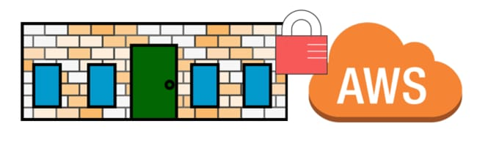
Security and Compliance
Latest electronic surveillance
Multi-factor access control systems
Trained security guards 24/7
Strict least-privileged access
Environmental systems
Multiple regions and Availability Zones

Slide 110

Reliability
High-performing and reliable solutions
Achieve greater flexibility/capacity
Reliability:
Recover from failures
Resources that demand and mitigate disruptions
Must have well-planned foundation
Reduce uncertainty of forecasting
Detect failure and automatically heal itself
Unmatched by on-premise solutions

Slide 111

Pricing: Pay as you go
Benefits
Redirect focus to innovation and invention
Adapt to changing business needs
Improve responsiveness to changes
Reduce risk or overprovisioning or missing capacity
Notes:
AWS menawarkan pendekatan bayar sesuai pemakaian untuk penetapan harga di lebih dari 160 layanan cloud. Dengan AWS, Anda hanya membayar layanan individual yang Anda perlukan, selama Anda menggunakannya, dan tanpa kontrak jangka panjang atau lisensi rumit. Harga AWS serupa dengan bagaimana Anda membayar keperluan seperti air dan listrik. Anda hanya membayar layanan yang digunakan, dan setelah Anda berhenti menggunakan, tidak ada biaya tambahan atau biaya penghentian.

Slide 112
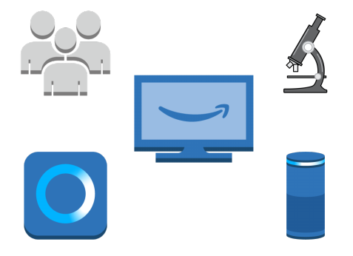
Conclusion
Connect with customers
Develop ground-breaking new insights
Scientific breakthroughs
Deliver innovative new products and services
Notes:
Kesimpulan :
AWS terhubung dengan pelanggan karena menyesuaikan dengan sumber daya yang dibutuhkan oleh pelanggan dan hanya membayarkan yang dipakai sesuai kebutuhan saja
Mengembangkan wawasan baru yang luar biasa
AWS memiliki terobosan ilmiah yang sangat baik dan memberikan produk beserta layanan baru yang sangat inovatif

Slide 113
LATIHAN

Slide 115





IKUTI KAMI
digitalent.kominfo
digitalent.kominfo
DTS_kominfo
Digital Talent Scholarship 2019
Pusat Pengembangan Profesi dan Sertifikasi
Badan Penelitian dan Pengembangan SDM
Kementerian Komunikasi dan Informatika
Jl. Medan Merdeka Barat No. 9
(Gd. Belakang Lt. 4 - 5)
Jakarta Pusat, 10110
digitalent.kominfo.go.id

